Slide 1
Introduction to Simulation and Modeling

Slide 2
Model Translation
(Lecture 17)

Slide 3
Introduction
Which components of the system should be included in the model and how the model should flow.
The objective of the model translation phase is to translate the system into a computer model that can be used to generate experimental data.
This is a two-step process. The first part of this process requires that the practitioner decide what type of computer program to utilize to model the system.
The second part of the model translation phase is to actually perform the programming of the simulation model.

Slide 4
Simulation Program Selection
simulation practitioner has the opportunity to choose among a wide variety of different computer simulation programs (Banks et al., 2000).
The practitioner’s choice of a particular simulation software package may be based on:
Advances in computer hardware
Software cost
Practitioner preference

Slide 5
Advances in Computer Hardware
Many advances have taken place in the microcomputer industry in the last two decades.
With the advent of high-powered microcomputers and photorealistic graphics, the practitioner can now illustrate his or her point.
Graphical simulation packages must carry user interface overhead calculations.
This means that calculation-intensive simulation applications may actually favour the use of general purpose programming languages

Slide 6
Software Acquisition and Costs
Another issue that may influence the decision to use either a simulation-specific program or a general purpose programming language is software cost.
most simulation software companies offer both academic and training/evaluation versions.
The downside to acquiring either an academic or training/evaluation version of the software is that it is undoubtedly restricted in some manner.

Slide 7
Software Acquisition and Costs
Some software companies restrict the program by limiting the number of entities that may be present in the model at any given time.
This can have the effect of limiting the size of the model that the practitioner can develop.
For example, the academic version of ARENA is limited to 150 entities at any given time.
Another approach commonly utilized by software companies is to keep full functionality of the program but to limit the amount of time that the software may be utilized.
At the end of the evaluation period, the practitioner has the opportunity to purchase the full version of the software.

Slide 8
Practitioner Preference
Sometimes the selection of the computer language or program to use comes down to the preference of the practitioner.
If, for example, the practitioner is a very accomplished general purpose programmer and the project is calculation intensive and does not require animation, it may be a wise decision to use a general purpose programming language

Slide 9
Simulation-Specific Programming Languages
here a number of simulation-specific programming languages currently on the market.
The number of these types of programs is probably increasing on a yearly basis.
Arena
Automod
Simscript

Slide 10
General Purpose Programming Languages
Virtually any general purpose high-level programming language can be used to create simulation models (Banks et al., 2000; Schriber, 1990).
This includes programming languages such as
Visual Basic,
C++,
FORTRAN,
Pascal.

Slide 11
Model Translation Section Content
The second part of the model translation process includes the actual programming of the system.
Following general simulation programming philosophy is provided to help insure that the practitioner develops robust and functional simulation models.
This philosophy includes approaches for:

Slide 12
Model Translation Section Content
Getting started
Version management
Programming commenting
Program organization
Mnemonic naming conventions
Advanced program planning
Multiple practitioner program development

Slide 13
Getting Started
Practitioner should have initially developed the high-level flow chart from the perspective of the system entities, there is a direct correlation to the actual simulation program.
If the practitioner has a conceptual high-level understanding of how the system operates, it will be far easier to expand the high-level flow chart to develop the lower-level simulation program code

Slide 14
Version Management
Addresses administrative issues to help assist the practitioner in creating and maintaining an organized program file system
Project subdirectories
Saving simulation programs
File version management techniques
Backing up simulation project files

Slide 15
Program Organization
The simulation practitioner must wage an endless battle to keep the simulation program as organized as possible.
Why simulation programs can easily become disorganized
How to use subroutines and subroutine views
Programming hot keys
Mnemonic naming conventions
Thinking in advance

Slide 16
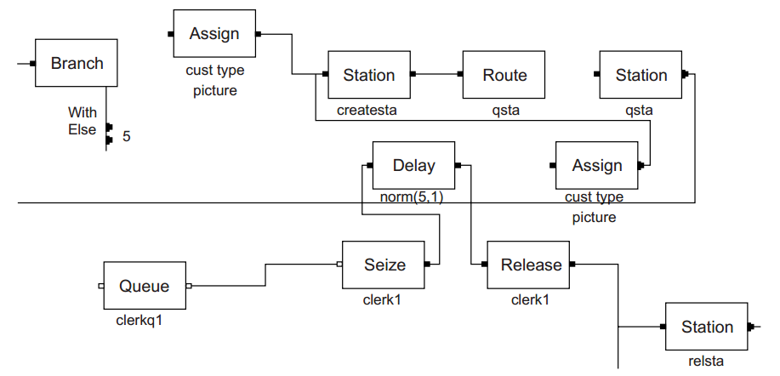

Goto approach to program organization (Spaghetti Code)

Slide 17
Mnemonic Naming Conventions
The practitioner should make every possible attempt to use consistent mnemonic naming conventions for the model queues, resources, transporters, and conveyors.
The naming convention should describe the exact nature of the component as well as what type of component it is.
Examples of mnemonic naming include:
•Checkoutclrk
•Checkoutclerkq
•Golfcart
•Golfcartq
•Bagconv
•Bagconvq

Slide 18
Thinking in Advance
Most simulation models usually end up being modified in some manner in order to represent different experimental alternatives.
Because the model may eventually be recycled, it is almost always of benefit to the practitioner to attempt to build as much flexibility into the model as is reasonably possible.
This approach is known in the industrial engineering worldas “right the first time.”

Slide 19
Thinking in Advance
A typical example of this situation is one in which the practitioner knows that the experimental alternatives will require a large and varied number of resources, queues, transporters, or conveyors.
In this case, it may be preferable to begin the model using an array approach.
Instead of individually referring to components in the model as mach1, mach2, etc., these components are referred to as machs(i), where i is an index variable identifying a particular machine in the array of machines called machs.
The array approach enables the practitioner easily to increase or decrease the number of components in the model.

Slide 20
Multiple-Practitioner Program Development
Under some circumstances, the practitioner may need the assistance of other practitioners in order to complete the programming component of a simulation project.
These circumstances may arise as a result of either a tight time schedule or specific skills that other practitioners may possess.
Ideally, the practitioner will have formalized the assignment of the different programming components in the existing linear responsibility chart.
If this was not previously conducted, the practitioner would be well advised to revisit the linear responsibility chart and include these details.
The revised linear responsibility chart should obviously be distributed to all of the other practitioners.

Slide 21
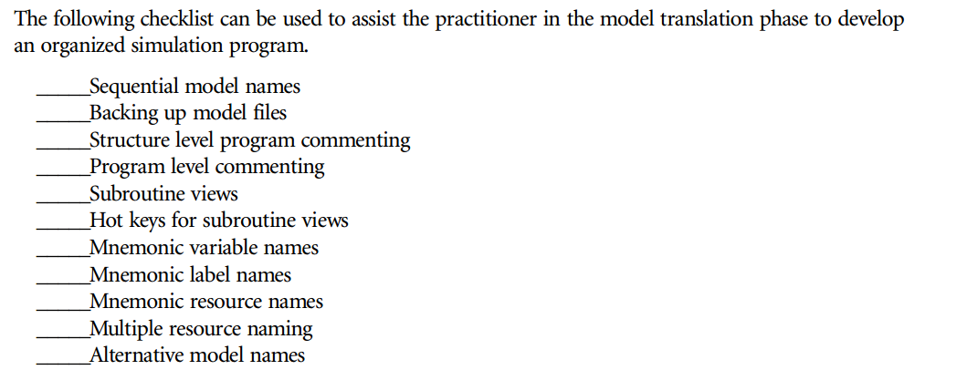
Model Translation Check List

Slide 22
Summary
Any Questions?

